Slide 1
New approaches in the learning of complex-valued neural networks
Vladyslav Kotsovsky, Anatoliy Batyuk, Maksym Yurchenko

Slide 2
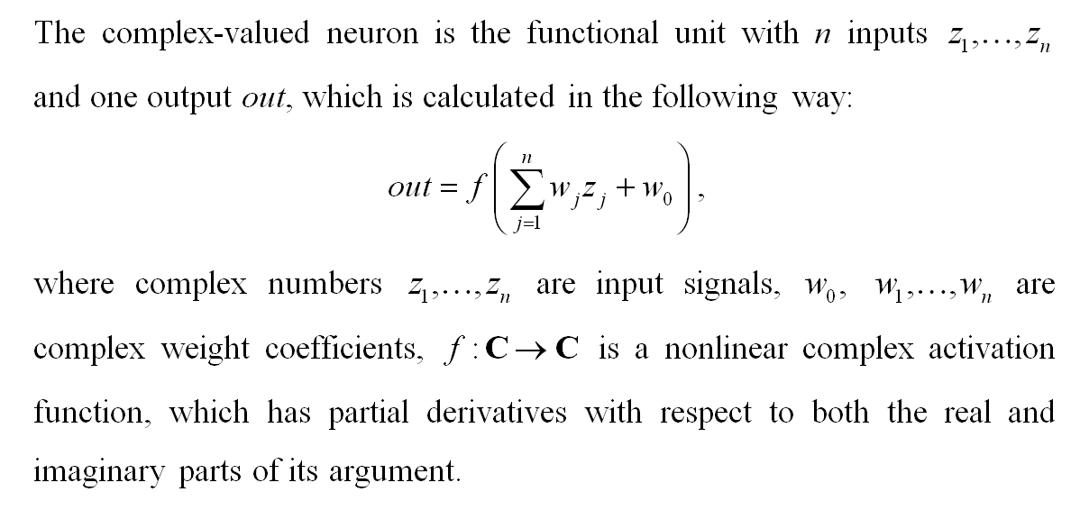
A model of Complex-valued neuron

Slide 3
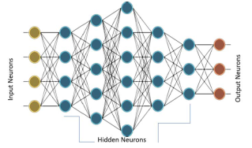
A Network Architecture

Slide 4
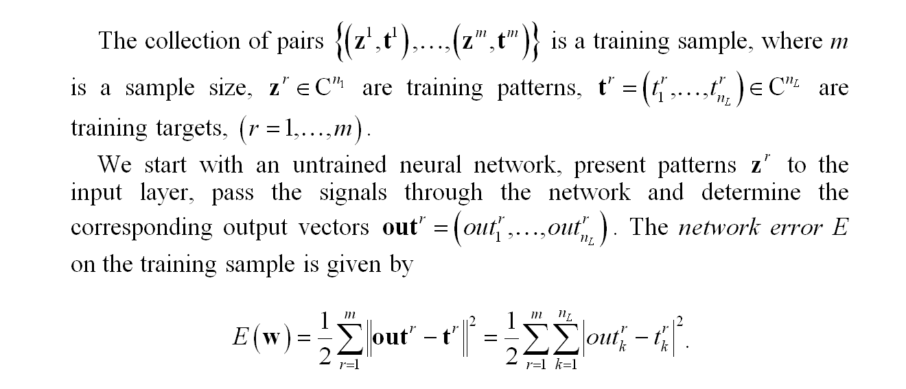
Network Error

Slide 5
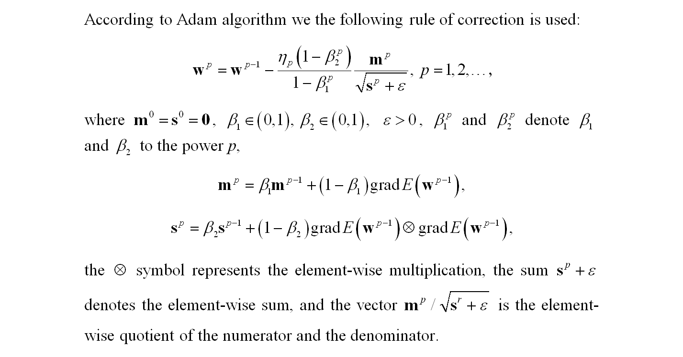
Adam optimizer

Slide 6
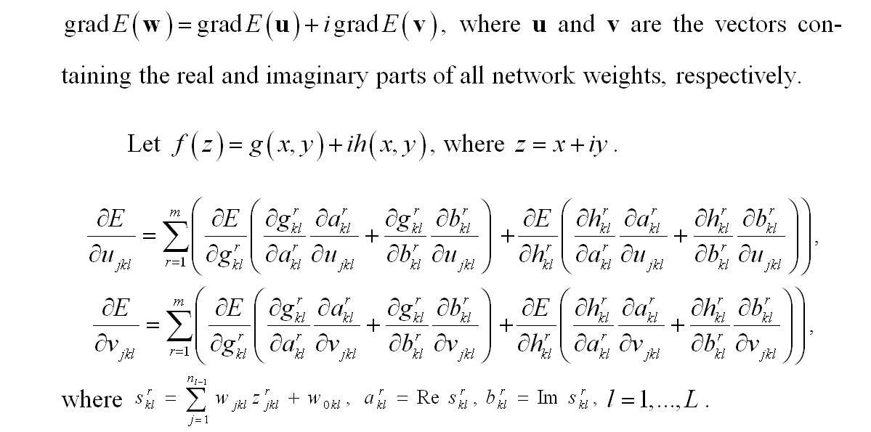
Calculation of the gradient

Slide 7
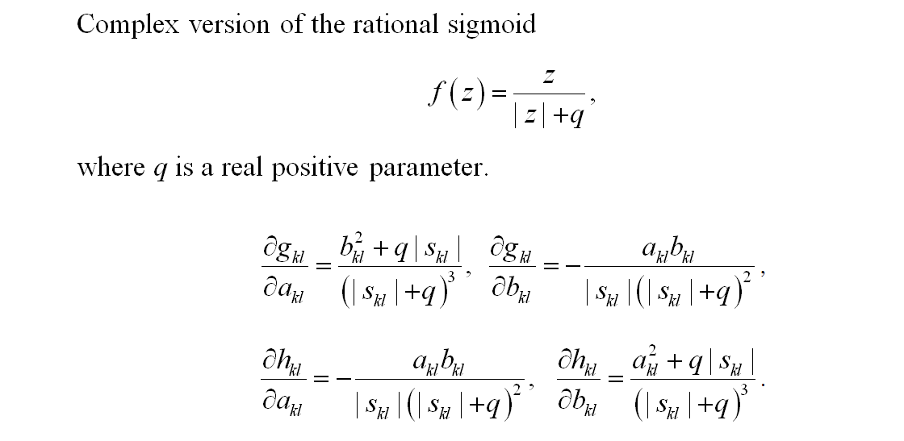
Choice of the activation function

Slide 8
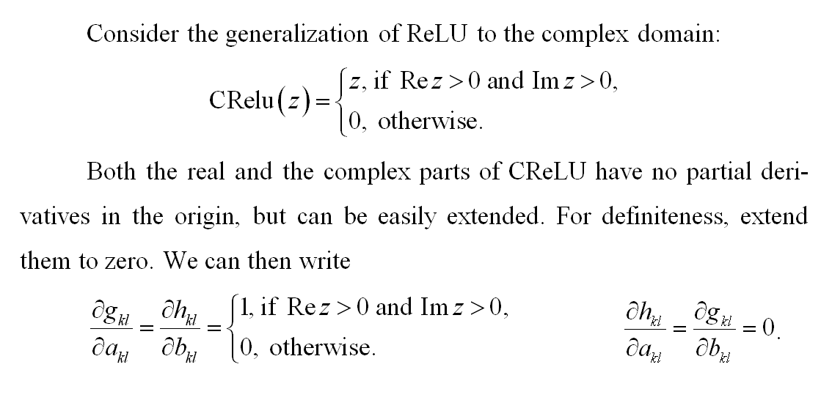
Choice of the activation function

Slide 9
simulation
We applied the complex backpropagation algorithm for solving the hard XOR problem in the case of 50 features.
We compared the performance of the real-valued and complex-valued four-layer networks consisting of neurons with sigmoidal and ReLU-like activation func­tions. We used 50-20-10-1 topo­logy in the real case and 25-20-10-1 to­pology in the complex case. Each network was trained in on-line mode on 100 dif­ferent learning samples. The number of epochs was equal to 1000. We use q = 1 for com­plex rational sig­moid.

Slide 10
simulation
The parameter β₁ and β₂ were initialized to 0.9 and 0.999, respectively. The following presents average per­for­mance mea­sures in the case of learning using sto­chas­tic gradient descent (SGD) and Adam opti­mizers, respectively.
Activation function | Average accuracy (in %)
 | Training set SGD | Test set SGD | Training set Adam | Test set Adam
Real sigmoid | 68.15 | 53.24 | 74.03 | 62.12
Splitted complex sigmoid | 71.92 | 62.25 | 82.88 | 67.03
Complex rational sigmoid | 73.01 | 62.19 | 85.35 | 67.76
CReLU | 74.96 | 67.05 | 92.43 | 81.51

Slide 11
conclusions
Feed-forward complex-valued neural networks give a simple and powerful architecture providing an adequate approximation of nonlinear mappings. The new activation functions and the complex modifications of effective modern optimizers improve the quality of learning. Using the results of simulation, we can conclude that the combination of CReLU activation and Adam optimizer is preferable under conditions of our experiment.
The new theoretical study and expe­riments are needed for tuning better parameters in the learning frame­work and establishing the behavior for such networks.

Slide 12
thank you for your time

