Slide 1
Power and Capacity of Bithreshold Neurons
Vladyslav Kotsovsky, Anatoliy Batyuk, ivan Mykoriak

Slide 2
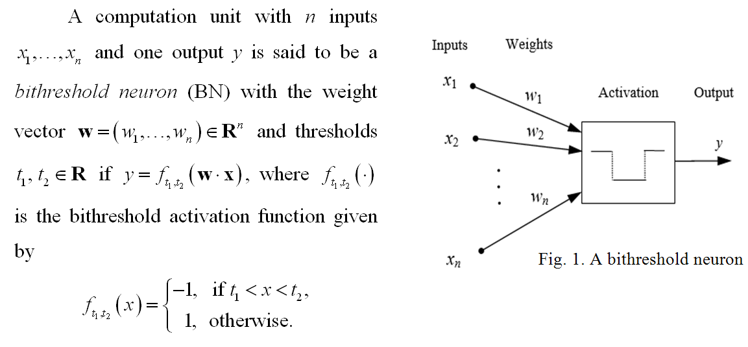
A model of bithreshold neuron

Slide 3
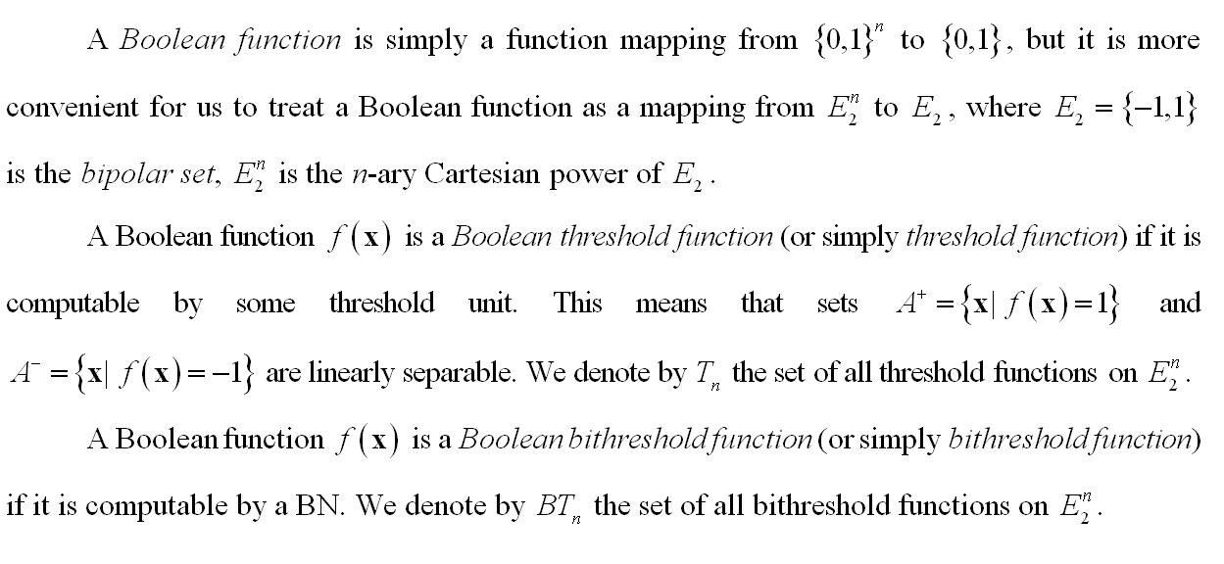
A bithreshold function

Slide 4
Problem statement

Slide 5
Upper bounds

Slide 6
Lower bounds

Slide 7
Estimation of the number of Bithreshold functions

Slide 8
conclusions

Slide 9
thank you for your time

