Slide 1
On the Size of Weights for Bithreshold Neurons and Networks
Vladyslav Kotsovsky, Anatoliy Batyuk, Volodymyr Voityshyn

Slide 2
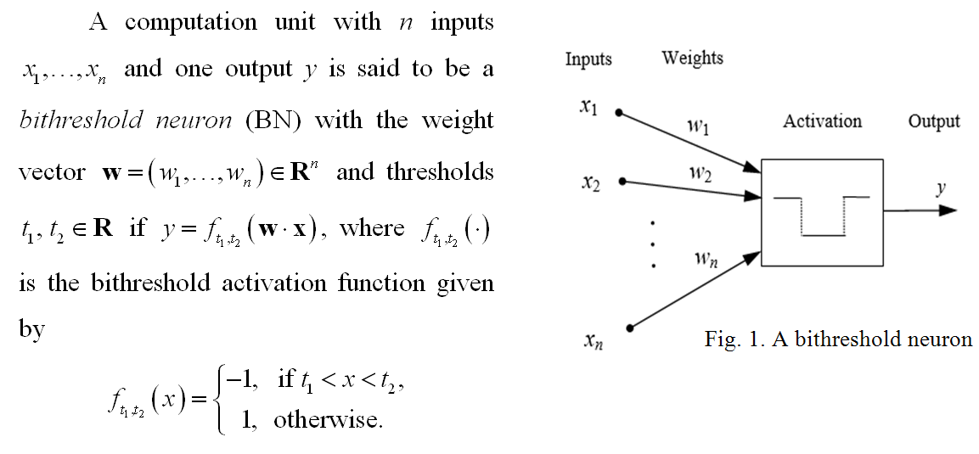
A model of bithreshold neuron

Slide 3
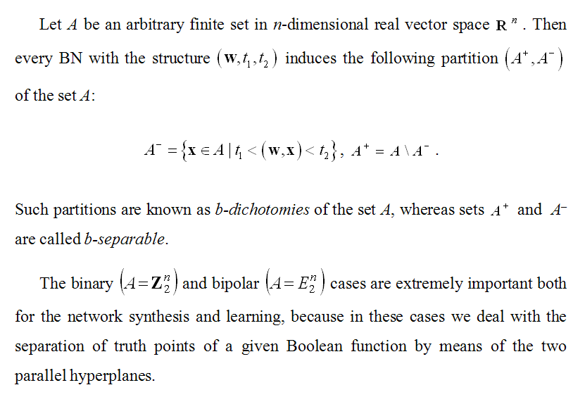
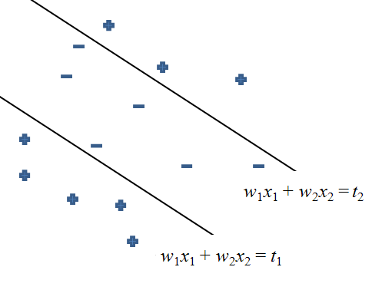
B-Separability

Slide 4
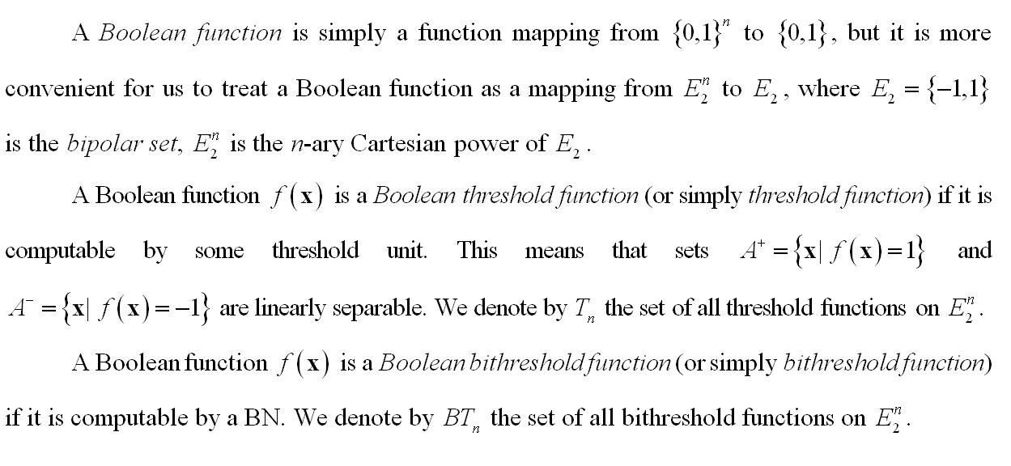
A bithreshold function

Slide 5
Problem statement
The goal of the research is the solution of the problem of memory capacity that is necessary to store all parameters of bithreshold neurons and networks.
Our work comprises:
Estimation of the norm of weight vector of BN producing a given b-dichotomy (A⁺, A–) of the finite set A.
Bounds on the size of the norm of the integer weight vector of bithreshold neurons realizing bithre­shold Boolean functions.
Estimate of the average and maximum capacity of the memory that is enough to store all weights of a bithre­shold neural network with integer inputs.

Slide 6
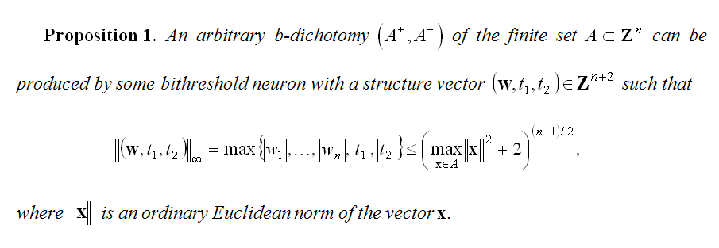
Bounds on the Size of Integer Weight Vector

Slide 7
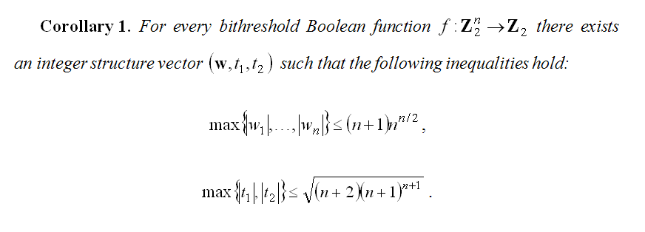
Bounds on the Size of Integer Weight Vectors

Slide 8
Bounds on the Size of Integer Weight Vectors

Slide 9
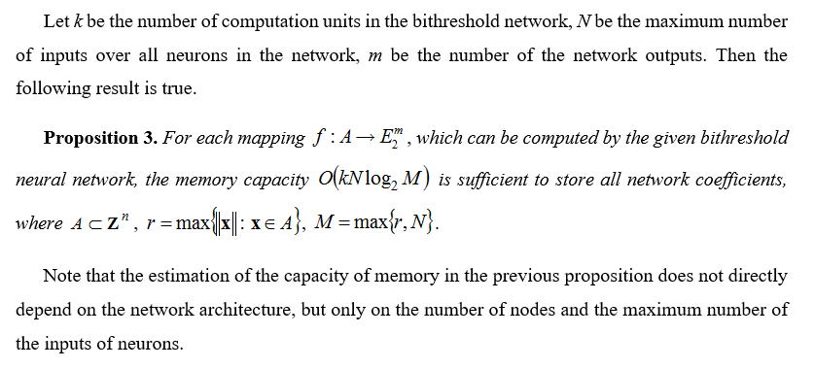
Memory CAPACITY of the Bithreshold Neural Network

Slide 10
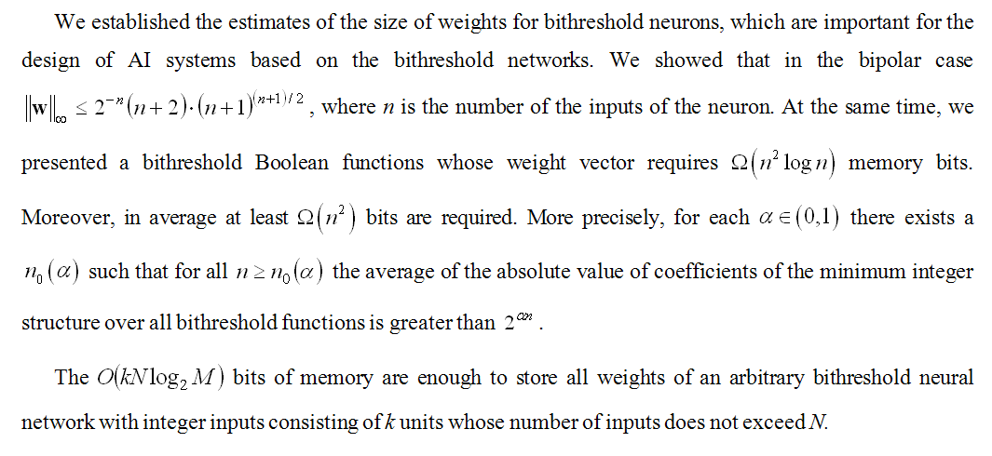
conclusions

Slide 11
thank you for your attention

