Slide 1
Decision List-Based Representation of Bithreshold Functions
Vladyslav Kotsovsky and Anatoliy Batyuk

Slide 2
goalS of research
Study of conditions on the terms of the decision list ensuring that it produces a bithreshold function.
Design and justification of the effective learning algorithm, which can be applied in the synthesis of the bithreshold neuron realizing the output function of the decision list.

Slide 3
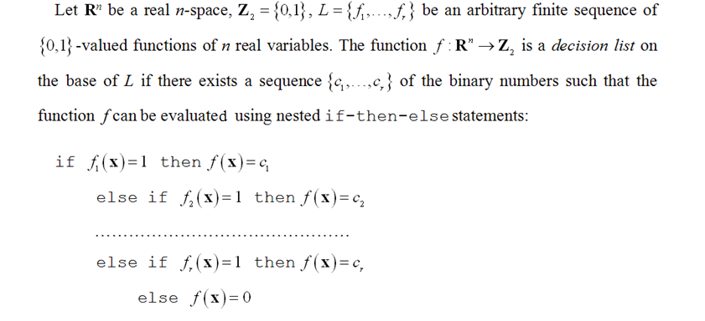
Decision List

Slide 4
model of bithreshold neuron

Slide 5
Bithreshold Functions

Slide 6
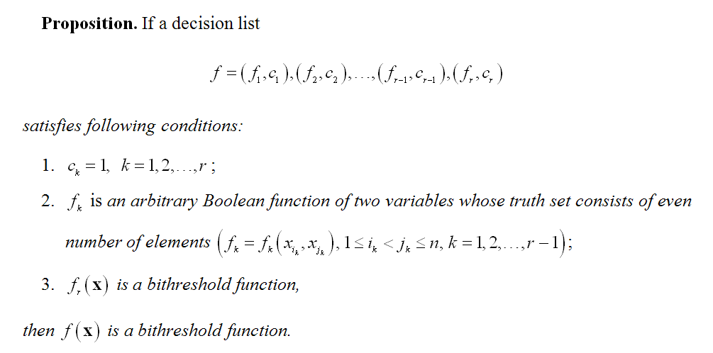
Theoretical foundation

Slide 7
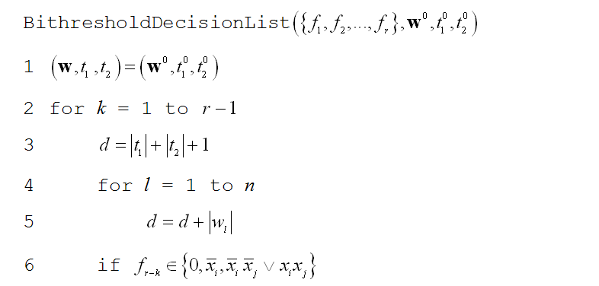
Learning Algorithm for Decision List

Slide 8
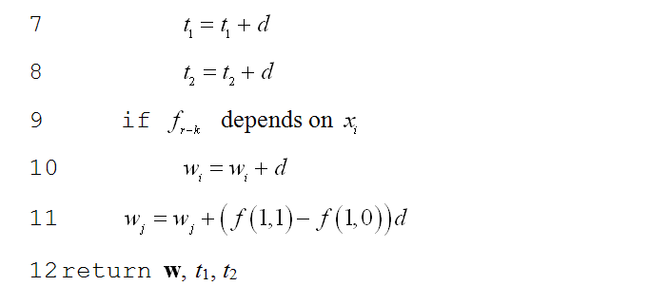
Learning Algorithm for Decision List

Slide 9
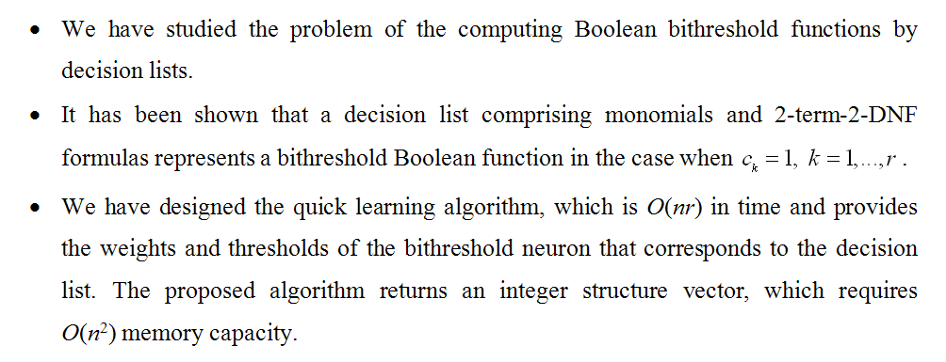
conclusions

Slide 10
thank you for your attention

