Slide 1
Dr HAYDER AL-ZUBAIDI
DEPARTMENT ASSISTANT/ DEPARTMENT OF ONCOLOGY
UZHHOROD NATIONAL UNIVERSITY
HODGKIN’S LYMPHOMA

Slide 2

OVERVIEW
HODGKIN’S LYMPHOMA (HL) (Hodgkin’s disease) is potentially curable malignant lymphoma
Thomas Hodgkin described it in 1852
Reed and Carl Stenberg first described the malignant cells of Hodgkin’s lymphoma called Reed Stenberg cells.
It is defined in terms of – microscopic appearance & expression of cell surface markers

Slide 3
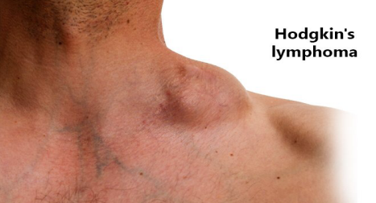

Slide 4
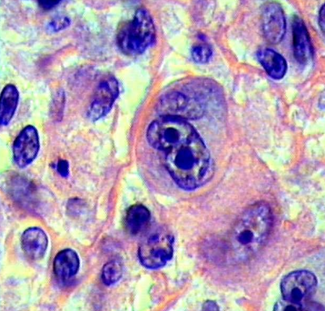

Slide 5
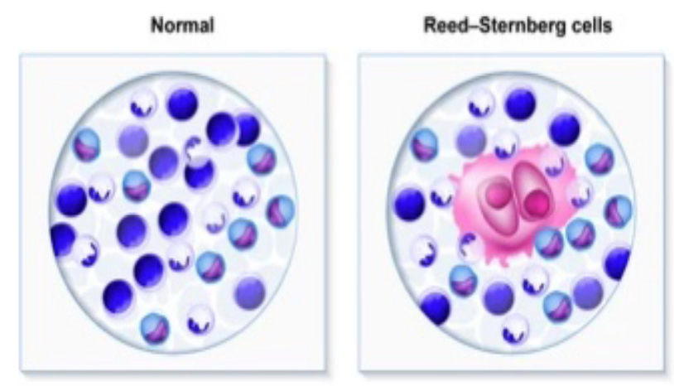

Slide 6
EPIDEMIOLOGY
Tumors of the immune system include Hodgkin's disease (Hodgkin’s lymphoma) and lymphocytic (non-Hodgkin) lymphoma. Lymphoma develop in the lymph nodes or lymphatic tissue extra nodal sites.
Lymphogranulomatosis occurs with a frequency of 3-4 cases per 100 000 population per year. Men suffer more (60-70% of cases). The average age of patients with Hodgkin's disease - 32 years, in other forms of lymphoma - 42 years.

Slide 7
EPIDEMIOLOGY
5 yrs. disease specific survival rate- stage 1 & 2 (90%), stage 3 (84%), stage 4 (65%).
HL more common in males than females & in males particularly in children
Age incidence is bimodal peaking in 15-34 yrs & >55 yrs.
NS HL in 15-34 yrs & MC HL in old & children

Slide 8
WHO CLASSIFICATION OF HL
Nodular Sclerosis Classical HL (NSCHL)
Mixed Cellularity Classical HL
Lymphocyte-Depleted Classical HL
Lymphocyte-Rich Classical HL
Nodular Lymphocyte Predominant

Slide 9
WHO CLASSIFICATION OF HL
Nodular sclerosis HL: 60-80% of all cases, affects mainly adolescents & young adults, involves mediastinum and other supra diaphragmatic sites
MC HL: 15-30% of all cases, commonly affects abdominal lymph nodes and spleen, pt. usually presents in advanced stage, common in HIV pt.
LD HL: less than 1% of cases, affects mainly old age and HIV +VE pt., usually present with advanced stage, cells shows expression of EB virus protein
LR HL: 5% of cases, requires immunohistochemical diagnosis, clinically similar to MC HD
NLPHD: 5% of cases, RS cells are infrequent or absent, pop corn cells (nuclei like exposed kernel of corn) are seen

Slide 10
RISK FACTORS
Epstein- Barr virus in 50% cases- more in MC HD (60- 70%) than NS HL (15-30%) (Incidence is about 2.55 times higher)
100% of HIV associated HL are EBV (HIV infection is associated with higher incidence of HL, but HL is not a AIDS defining neoplasm)
First degree relatives have five fold increase in risk for HL
High socio economic status.
Prolonged uses of human growth hormone

Slide 11
The staging of HL follows the Ann Arbor classiﬁcation
■ Stage 1 – Involved lymph nodes limited to one node area only
■ Stage 2 – Involved lymph nodes involving two or more adjacent areas but remaining on one side of the diaphragm only
■ Stage 3 – Involved lymph nodes on both sides of the diaphragm
■ Stage 4 – Involvement of extranodal organs denoted by the following sufﬁxes:
M – bone marrow
D – skin
H – liver
S – spleen.

Slide 12
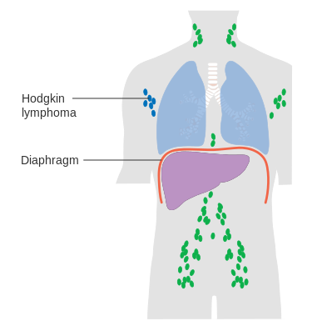
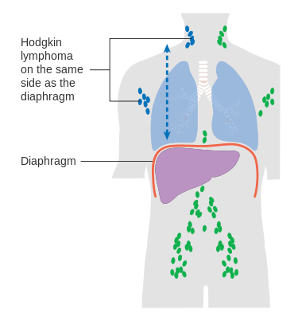
Ann Arbor classiﬁcation

Slide 13
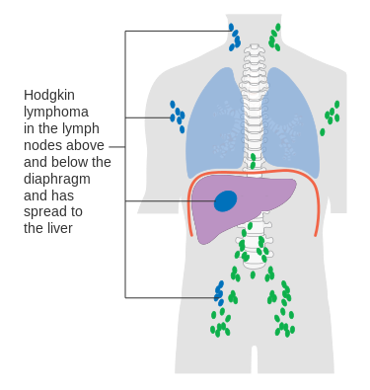
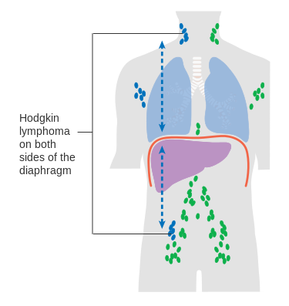
Ann Arbor classiﬁcation

Slide 14
A or B
A or B designations denotes presence or absence of B symptoms (A designation is absence of these) B designation includes presence of one or more of :
fever (>38 C),
night sweats,
unexplained loss of >10% of body weight within preceding 6 mths.

Slide 15
Atypical presentations
Unexplained itching,
cutaneous disorders such as erythema nodosum
paraneoplastic cerebellar degeneration ,
nephrotic syndrome,
immune hemolytic anemia & thrombocytopenia, hypercalcemia
pain in lymph node region on alcohol ingestion (is specific for HL but is seen in less than 10% of patients
back/bone pain is rare

Slide 16
Clinical presentation
Typically the patient is aware of a painless enlarged node in the neck. This might have been present for many weeks or months but can develop more rapidly.
‘B’ symptoms are characteristic of lymphomas and are:
fever >38°C often with typical remittent pattern (Pel–Ebstein fever)
weight loss of >10 per cent body weight
night sweats (that include profound sweating, sufﬁcient to drench bedclothes
These constitutional symptoms are prognostically important.

Slide 17
Clinical presentation
Other uncommon but characteristic symptoms include generalized and often intractable itching and alcohol-induced pain in the enlarged nodes. Although the lymph nodes themselves are usually painless there might be some backache from para-aortic nodes and left sided abdominal pain from splenic enlargement

Slide 18
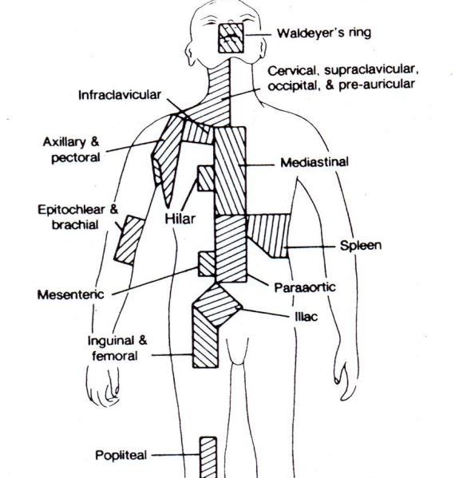

Slide 19
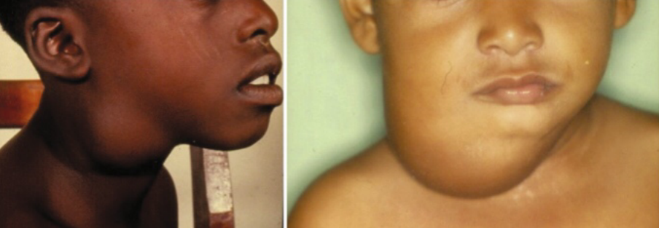

Slide 20
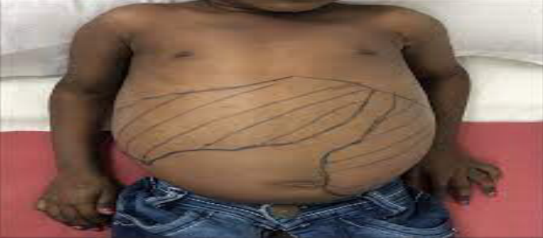
HEPATOSPLEENOMEGALY

Slide 21
Investigation
Physical examination: palpable painless lymphadenopathy, rubbery consistency
cervical (60-80%), axillae (6-20%), inguinal (6-20%).
Waldeyer’s ring or occipital/epitrochlear lymphadenopathy rare.
Splenomegaly, hepatomegaly, SVC syndrome due to mediastinal lymphadenopathy, CNS symptoms ( multi focal leukoencephalopathy)

Slide 22
Investigation
BIOCHEMICAL:
ESR- elevated level - poor prognosis,
LDH- correlate with bulk of disease,
CBC- anemia of chronic disease, lymphopenia, neutrophilia, eosinophilia.
Serum creatinine – for nephrotic syndrome,
ALP- liver/bone marrow involvement,
elevated serum calcium and sodium, hypoglycemia (due to presence of insulin auto antibodies)
HIV test : as anti retroviral therapy can improve outcome in positive pations

Slide 23
Investigation
Biopsy
A tissue diagnosis is mandatory to conﬁrm the diagnosis and deﬁne the histological subtype of HL. This will usually take the form of an open lymph node biopsy where there is an accessible node in the neck, axilla, supraclavicular fossa or groin. Mediastinoscopy or laparoscopy could be required where there are no other sites accessible for biopsy.

Slide 24
Investigation
Staging laparotomies (biopsy of liver, splenectomy & biopsy from multiple lymph nodes i.e. para aortic, mesenteric, portal & splenic hilar region if enlarged) were once popular for most patients with HL but are now done rarely because of an increased reliance on systemic rather than local therapy. The procedure can be helpful in rare cases where radio therapy is considered as sole t/t of early stage HL

Slide 25
Investigation
Chest X-ray can show widened mediastinal shadow owing to enlarged nodes or, more rarely, lung parenchymal inﬁltration. Pleural effusion is also a recognized ﬁnding.
CT and MRI CT scan of the chest, abdomen and pelvis will give the most accurate assessment of internal lymphadenopathy and has now superseded the use of bipedal lymphangiography as the imaging of choice for staging in lymphoma.
Additional staging information can be seen on ﬂuorodeoxyglucose PET scans with normal size nodes demonstrating increased uptake indicative of lymphoma. PET can also have an important role in response assessment and follow-up.

Slide 26
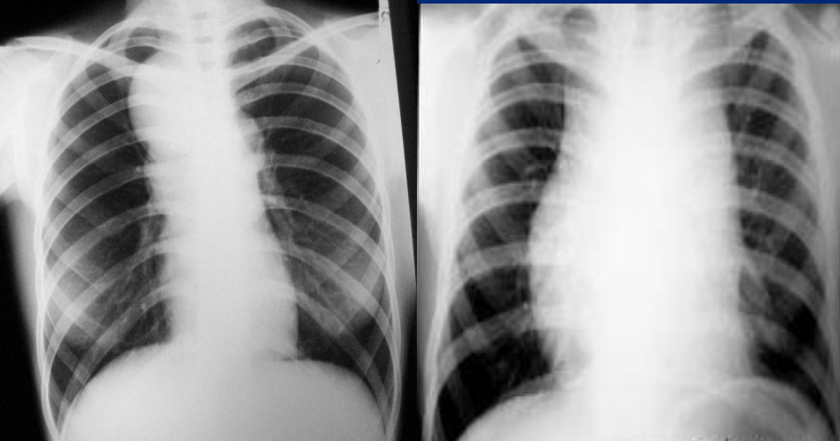

Slide 27
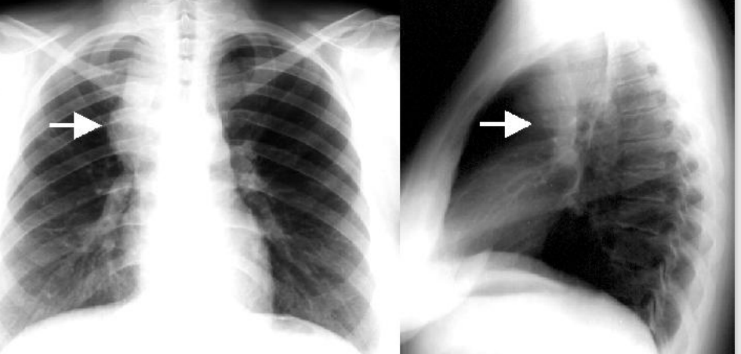

Slide 28
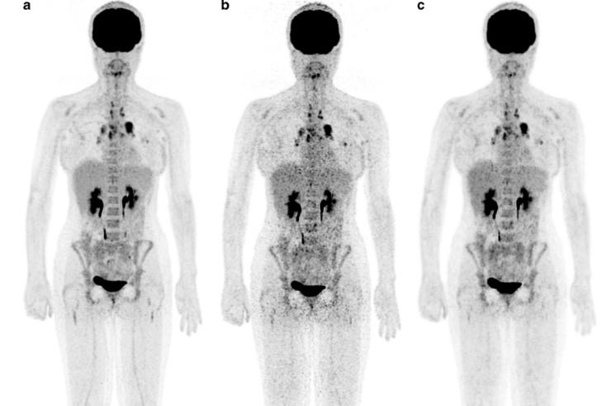

Slide 29
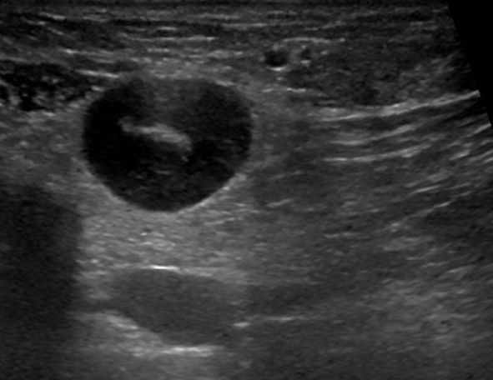
Ultrasonography

Slide 30
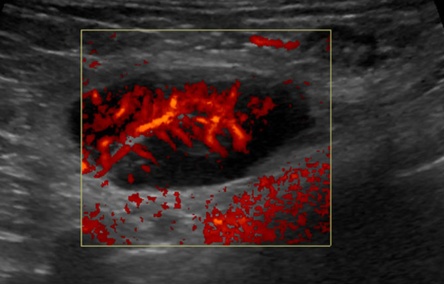
Ultrasonography

Slide 31
UNFAVORABLE FACTORS IN EARLY STAGE HL
Bulky disease: defined as mediastinal mass >1/3 of intra thoracic diameter on CXRAY or >35% of thoracic diameter at vertebral level T5-6 or >10 cm in diameter on CT scan
ESR ≥ 50 if pt. is otherwise asymptomatic
> 3 sites of HL involvement
The presence B symptoms
The presence of extra nodal disease

Slide 32
Treatment of HL
Specific risk factors for unfavorable prognosis include: the presence of 3 or more involved lymph node areas, elevated ESR, bulky mediastinal mass and extra nodal disease.
The preferred treatment for early-stage disease is combined-modality therapy consisting of combination chemotherapy (typically ABVD [doxorubicin, bleomycin, vinblastine, dacarbazine]) followed by involved-field radiotherapy.

Slide 33
Treatment of HL
Favorable disease is treated with 2 cycles of ABVD followed by 20 Gy radiation while unfavorable disease is typically treated with 4 cycles of ABVD followed by 30 Gy radiation.
Intensive chemotherapy with 2 cycles of escalated BEACOPP (bleomycin, etoposide, doxorubicin, cyclophosphamide, vincristine, procarbazine, prednisolone) followed by 2 cycles of ABVD and radiotherapy improves tumor control in high-risk patients at the cost of higher toxicity.

Slide 34
Treatment of HL
Advanced (stage III to stage IV) HL
The goal of therapy is cure. Initial treatment should be combination chemotherapy. Acceptable regimens include ABVD or escalated BEACOPP. Stanford V chemotherapy (doxorubicin, vinblastine, chlormethine, vincristine, bleomycin, etoposide, prednisolone) can be considered. The role of consolidation radiotherapy in advanced HL is controversial but generally recommended for patients with bulky disease (>5 cm), or for patients receiving Stanford V, in which radiotherapy is an essential component.

Slide 35
Treatment of HL
The acute side effects of therapy depend on the region treated and the dose employed. Most patients treated to the mediastinum develop esophagitis, clinically apparent as odynophagia that sometimes requires narcotic analgesics to maintain oral intake. Infra-diaphragmatic radiotherapy can cause nausea and/or diarrhea. Fatigue is common in all patients receiving radiotherapy

Slide 36
Treatment of HL
Refractory and relapsed disease
Management of relapsed HL must be individualised. The goal of therapy, at least initially, remains curative. The recommended treatment will vary and depends on several factors including previous first-line treatment (radiotherapy alone, chemotherapy alone, or combined-modality therapy), patient age and medical comorbidities, duration of first remission, and stage at relapse.

Slide 37
Treatment of HL
Secondary Therapy of Classical HL Fortunately, fewer patients with Hodgkin’s lymphoma currently progress after primary treatment. Those with advanced disease may be offered :
High-Dose Chemotherapy with either the CBV (cyclophosphamide, carmustine, etoposide) or BEAM (carmustine, etoposide, cytarabine, melphalan) regimen followed by Autologous Stem Cell Transplantation has been the most successful approach .

Slide 38
Role of surgery in HL
Surgery can be used to obtain biopsy samples for diagnosing and classifying Hodgkin lymphoma, but it is rarely used as a treatment, considering that lymphomas do not often produce solid tumors in the way that many other cancers do. However, surgery may be used in rare cases of extra nodal lymphoma, where the condition develops outside of the lymph nodes (in the thyroid gland or the stomach, for instance).

Slide 39
Role of surgery in HL
Rare instances in which surgery may be used to address Hodgkin lymphoma include:
During diagnosis – When diagnosing lymphoma, it’s typically ideal to examine an entire lymph node for signs of cancer. Surgeons may recommend removing one or more lymph nodes through an open excisional biopsy.
During staging – To determine if a patient’s lymphoma is confined to one specific area or if it has spread throughout the body, surgeons may perform a procedure known as a staging laparotomy.
When treating symptoms such as pain, weakness and appetite loss – A splenectomy may be recommended for patients who are experiencing a reduced quality of life due to Hodgkin lymphoma side effects. This procedure may also be helpful for managing a platelet, iron or white blood cell deficiency following Hodgkin lymphoma treatment.

Slide 40
FOLLOW UP OF PATIENTS
Most relapse in first 3 yrs after therapy Follow every 2-4 mths for first 1-2 years & every 3-6 mths for next 3-5 yrs
examinations:
1. History & physical examination
2. CBC, LDH, ESR, glucose, lipids
3. TSH: annually in pts of hx/RT
4. CXRay & CT scan of chest every 3-6 mths for first 2-3 yrs then at least annually up to 5 yrs

Slide 41
FOLLOW UP OF PATIENTS
5. Abdomen & pelvis CT every 3-12 months (if indicated)
6. PET scan not specifically recommended
7. Spiral CT chest 5 yrs after for lung cancer
8. Mammography in female patients annually from 40 yrs or 5-8 yrs after RT

Slide 42
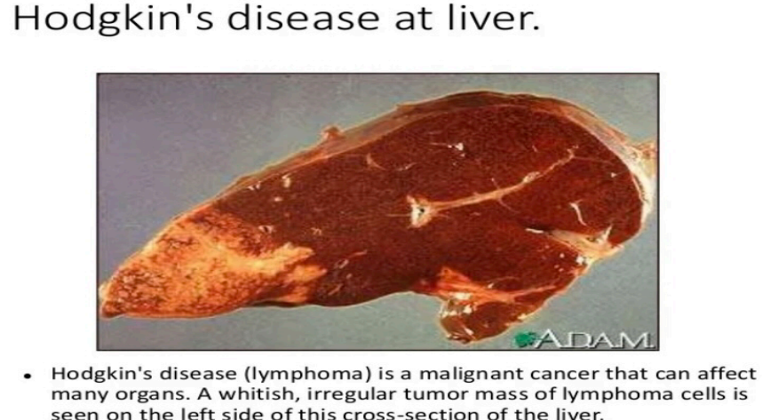

Slide 43
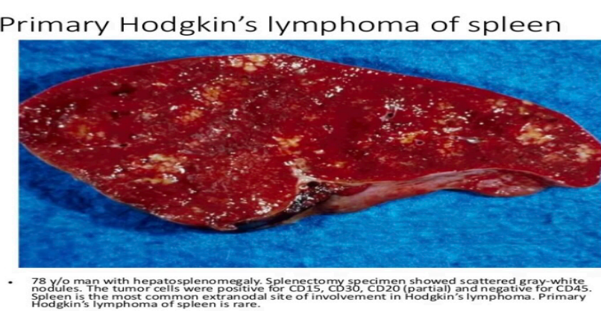

Slide 44
THANK YOU FOR ATTENTION
Dr HAYDER AL-ZUBAIDI
DEPARTMENT ASSISTANT/ DEPARTMENT OF ONCOLOGY
UZHHOROD NATIONAL UNIVERSITY

