Slide 1
 | The 13th ICEEE-2022 Online International Annual Conference on “Global Environmental Development & Sustainability: Research, Engineering & Management”
SUSTAINABLE REAGENTS FOR PRODUCTION OF FUSED HETEROCYCLES VIA ELECTROPHILIC HETEROCYCLIZATION
SLIVKA Mikhailo, MOYZESH Olexander, GRYGORKA Hanna, KOROL Nataliya, FIZER Maksym, MARIYCHUK Ruslan

Slide 2
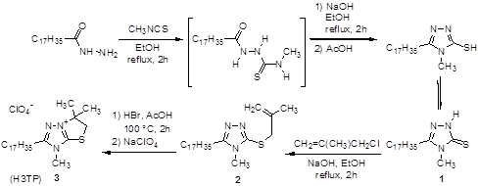
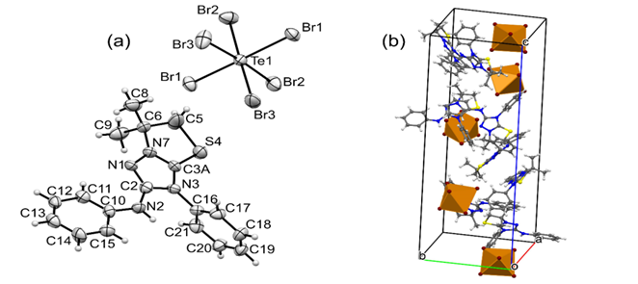
 | The 13th ICEEE-2022 Online International Annual Conference on “Global Environmental Development & Sustainability: Research, Engineering & Management”

Slide 3
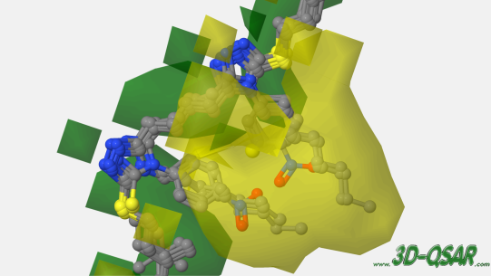
 | The 13th ICEEE-2022 Online International Annual Conference on “Global Environmental Development & Sustainability: Research, Engineering & Management”
CoMFA STUDY AS AN EFFICIENT APPROACH FOR THE DESIGN OF BIOLOGICALLY ACTIVE BIS-1,2,4-TRIAZOLES
CoMFA contour map showing the electrostatic of compounds 1-6.

Slide 4
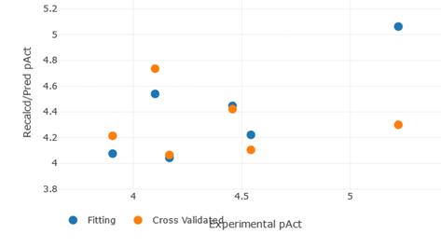
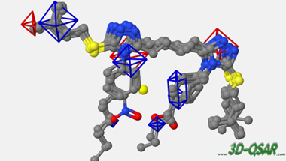
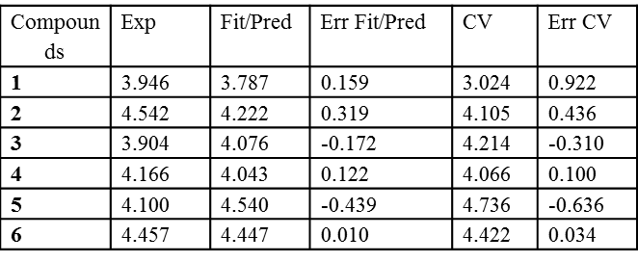
 | The 13th ICEEE-2022 Online International Annual Conference on “Global Environmental Development & Sustainability: Research, Engineering & Management”
CoMFA contour map showing the electrostatic of compounds 1-6.

Slide 5
 | The 13th ICEEE-2022 Online International Annual Conference on “Global Environmental Development & Sustainability: Research, Engineering & Management”
THANK YOU
FOR ATTENTION !!!

