Slide 1
Hyperparameter Tuning in the Learning of Multithreshold Neurons
Vladyslav Kotsovsky, Lisovska Tetiana

Slide 2
Relevance of the problem
Multithreshold-based neural systems are more powerful compared to the single-threshold ones and is successfully employed in the machine learning, e.g. in pattern classifi-cation.
The design of fast learning algorithms as well as the proper choice of their hyperparameters allow to use the capacity of multithreshold paradigm more effectively.

Slide 3
Goals of the research
The development of the learning algorithm for a multi-valued multithreshold neuron that should effectively use the advan­tages of multiple thresholds.
The study of its finiteness for intended applications in classification.
Investigation what values of algorithm hyperparameters would be used in order to speed-up the training process and improve the capacity of resulting neuron.

Slide 4
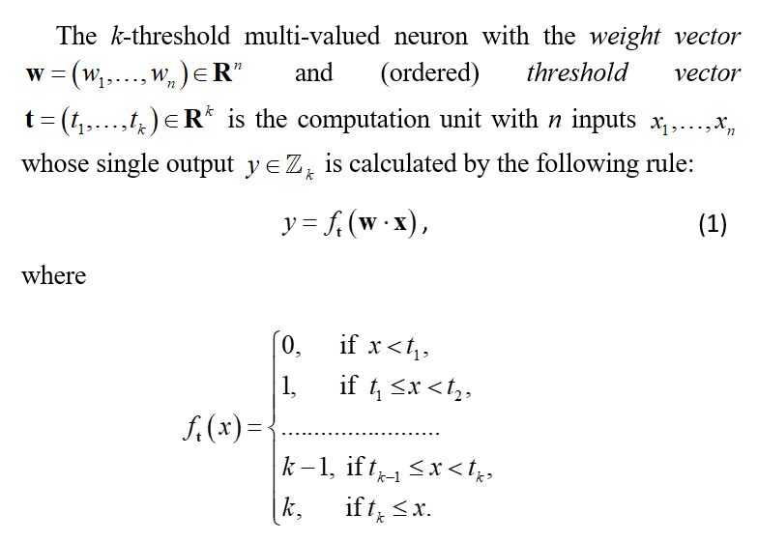
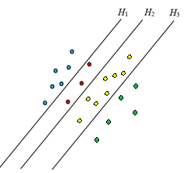
Model of multi-valued k-threshold neuron

Slide 5
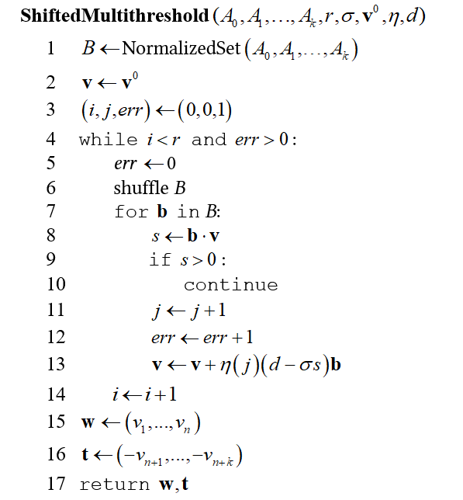
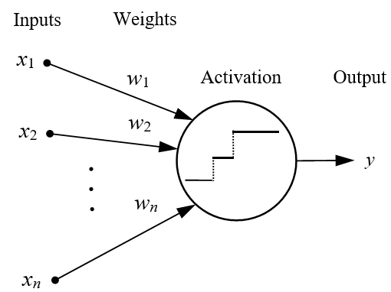
Online learning algorithm

Slide 6
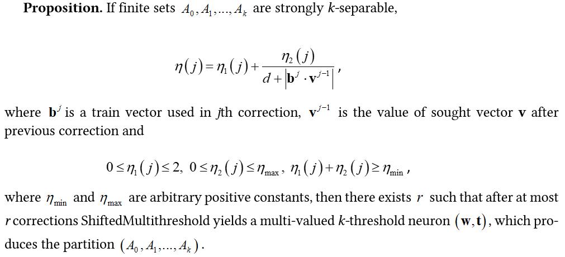
Convergence of Learning

Slide 7
Hyperparameter tuning
Performance comparison for different σ
Performance comparison for initial approximations
Dataset size | Average number of corrections
258 | 1413.51 | 157.14
512 | 3701.84 | 218.03
1024 | 8989.07 | 274.27
2048 | 15791.62 | 338.86
4096 | 20159.93 | 415.48
Dataset size | Average number of corrections
 | Random | Optimized
258 | 157.14 | 46.52
512 | 218.03 | 90.99
1024 | 274.27 | 133.37
2048 | 338.86 | 167.3
4096 | 415.48 | 216.71
Performance results for constant learning rates
Dataset size | Best learning rate | Average number of corrections
258 | 1.949 | 44.01
512 | 1.986 | 88.24
1024 | 2.003 | 128.81
2048 | 1.928 | 162.08
4096 | 2.051 | 201.33

Slide 8
Results on real-world datasets
Classifier | Accuracy on training set (in %) |  | Accuracy on test set (in %)
 | balance-scale | dry-bean | balance-scale | dry-bean
Perceptron | 84.25 | 20.91 | 82.23 | 16.59
5-Nearest Neighbor | 88.07 | 81.07 | 81.85 | 72.34
Random Forest | 100 | 99.98 | 82.93 | 90.03
MLP Classifier | 95.28 | 53.51 | 92.74 | 49.60
Multithreshold | 88.84 | 57.23 | 83.89 | 51.22
Multithreshold algorithm performed well on 3-class classi­fication task on balance-scale dataset and the online modification had the second-best accuracy on the test set.
Classification on the dry-bean datasets was more difficult. Learning for both linear perceptron and MLP failed completely. Multi-valued MTN yielded had the best accuracy among all considered neural-like models. But its accuracy was considerably worse than in the case of the use of random forest classifier.

Slide 9
conclusions
The proposed online learning algorithm is able to learn a multi-valued k-threshold neural unit, whose performance is concurrent compared to popular classifiers.
The learning mode defined by σ is extremely significant to the performance of online learning and its proper value 1 decreases the number of corrections in 10 times.
The initial approximation also matters. The use of the improved approximation requires additional calculations but this can reduce the number of corrections in 2–4 times compared to random initial approximation.
Constant learning rate in the case 1.93 < η < 2.05 is good choice for the relaxation learning.
The generalization ability of k-threshold neuron decreases with the growth of k.
The shift hyperparameter d has mainly the theoretical importance as a guarantee of the finite learning. Its practical application is limited by small values, whereas larger d can significantly decrease the learning process.

Slide 10
thank you for your attention

