Slide 1
Towards the Design of Bithreshold ANN Regressor
Vladyslav Kotsovsky and and Anatoliy Batyuk

Slide 2
Goals of the research
Study of the application of multithreshold approach in the predicting of continuous values.
The design of a neural network bithreshold regressor and the investigation of its performance.

Slide 3
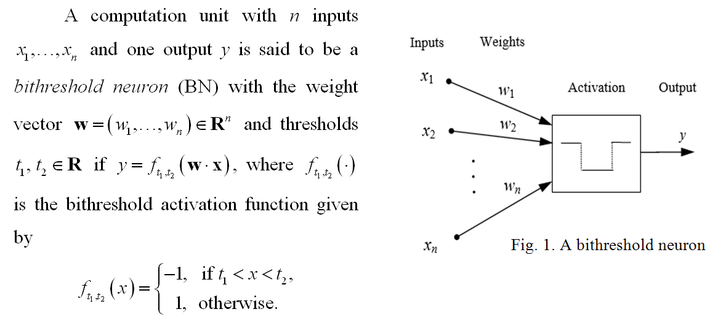
A model of bithreshold neuron (BN)

Slide 4
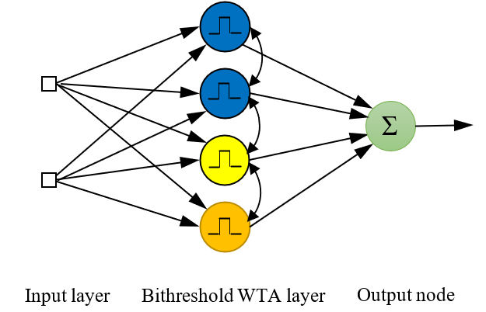
2-layer 3-level bithreshold NN regressor

Slide 5
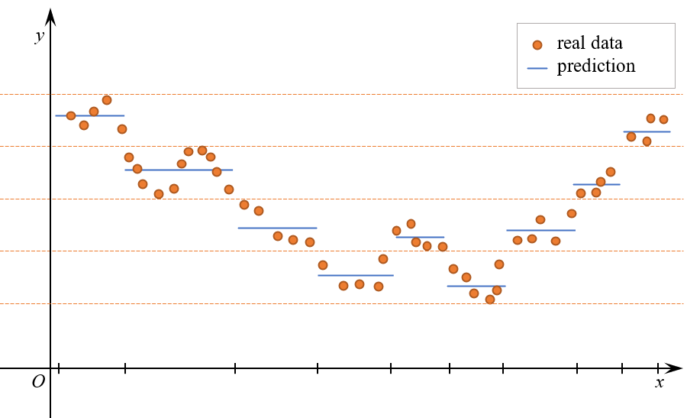
performance of bithreshold NN regressor

Slide 6
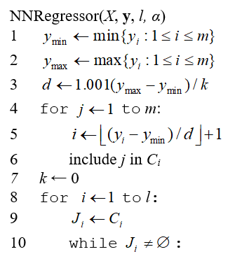
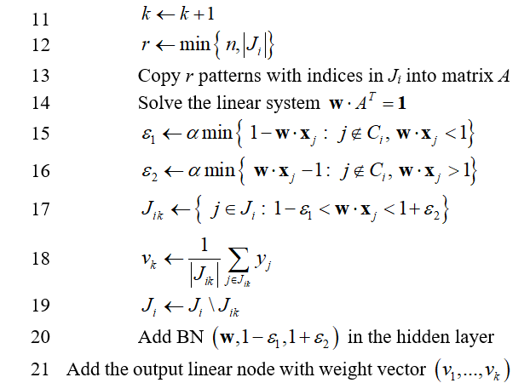
LEARNING OF L-LEVEL NEURAL NETWORK REGRESSOR

Slide 7
experiment Results
Results of Simulation
Regression model | Average value of metric
 | MSE | MAE | MAPE | R²
Linear | 0.543 | 0.5376 | 32.034 | 0.6023
5-nearest neighbors | 0.4286 | 0.4438 | 24.7145 | 0.6862
Kernel ridge | 0.3615 | 0.4237 | 24.5078 | 0.7353
Decision tree | 0.5084 | 0.5222 | 32.697 | 0.6281
SVR | 0.3541 | 0.398 | 21.6709 | 0.7408
MLP | 0.2968 | 0.3762 | 21.5266 | 0.7826
Bithreshold NN | 0.3409 | 0.4098 | 23.6387 | 0.7412

Slide 8
experiment Results
MLP regressor showed the best results by all four performance metrics.
Bithreshold NN was third best by first three metrics and second best by R2 metrics.
The best results provided by the random search were obtained in the case $α≈1$. Larger values of $α$ did not provide the improvement of the performance.
The number of discretization levels must be large enough to provide the good prediction capability of regression model.

Slide 9
conclusions
The model of the multi­le­vel 2-layer neural network with hidden layer consisting of bithre­shold-like neural units has been designed, using the superposition of bithreshold and winner-take-all computing principles in the activation of the hidden layer nodes as well as a single output node with linear activation.
The proposed model can be useful in the solving regression problems. The model-based approach to the learning of such networks has been proposed in which the size of the hidden layer is not predefined, but depends on the number of the discretization levels as well as on the distributions of training instances.
Two hyperparameters of the learning algorithm allow to re­gulate the approximation ca­pa­bility of the network and to ad­just its ability to genera­li­zation.
The presented simulation results con­firms that designed offline learning algo­rithm produces a l-level bithre­shold NN, which is concurrent com­pared to popular ma­chine learning regression models.

Slide 10
thank you for your attention

